Slide 1



Gosh Unified Debriefing Tool
And Advocacy Inquiry
Workshop

Slide 2
What Sim adds?
Simulated realism exposes a representative performance by the learner
Temporarily removing the ‘I’m great’ shield.
By using counselling/facilitation techniques standard for counsellors/psychotherapists one can uncover the hidden ‘frames of thinking’.
‘frames of thinking’ is the key to behavioural change

Slide 3
Team Performance Review
Delivered action
Desired action
Performance
Gap
Human Factor
Issues
Technical Skills
Cognitive or Procedural
Non Technical Skills
Communication
Leadership
Situational Assessment
Situational Awareness
Problem solving
Decision Making
Flexibility
Anticipation—looking ahead

Slide 4
Team Performance Review
Delivered action
Desired action
Performance
Gap
Human Factor
Issues
Technical Skills
Cognitive or Procedural
Non Technical Skills
Teach
Debrief the behaviour and attitude
hidden within.

Slide 5
Evolution of Debriefing Theory
Adopted standard facilitation techniques
  1) Initial reaction
    Enables candidates to release emotions they may be focused on
    Reveals performance issue the candidates are concerned by-ripe for a ‘frame’ of mind open for change
  2) Encourage candidates to Describe the issues
  3) Analyse the issue to bring Solutions

Slide 6
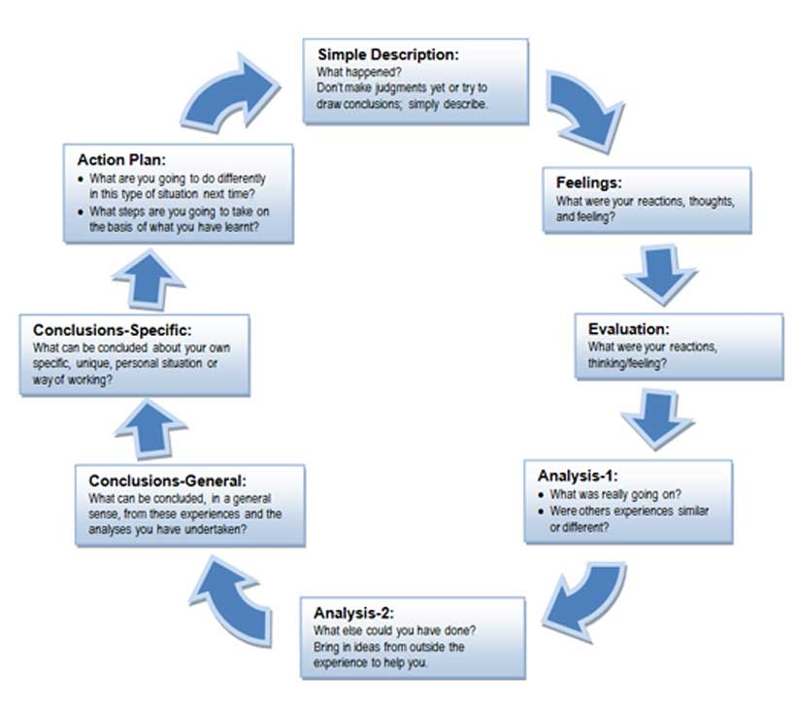

Slide 7
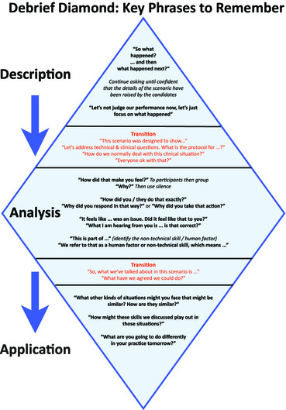

Slide 8
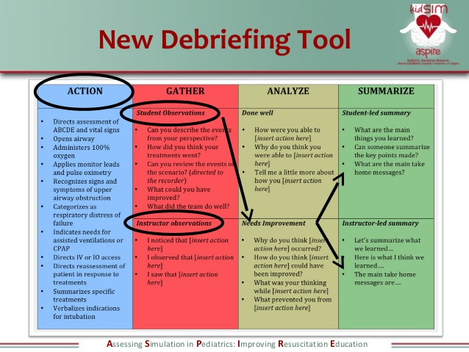

Slide 9
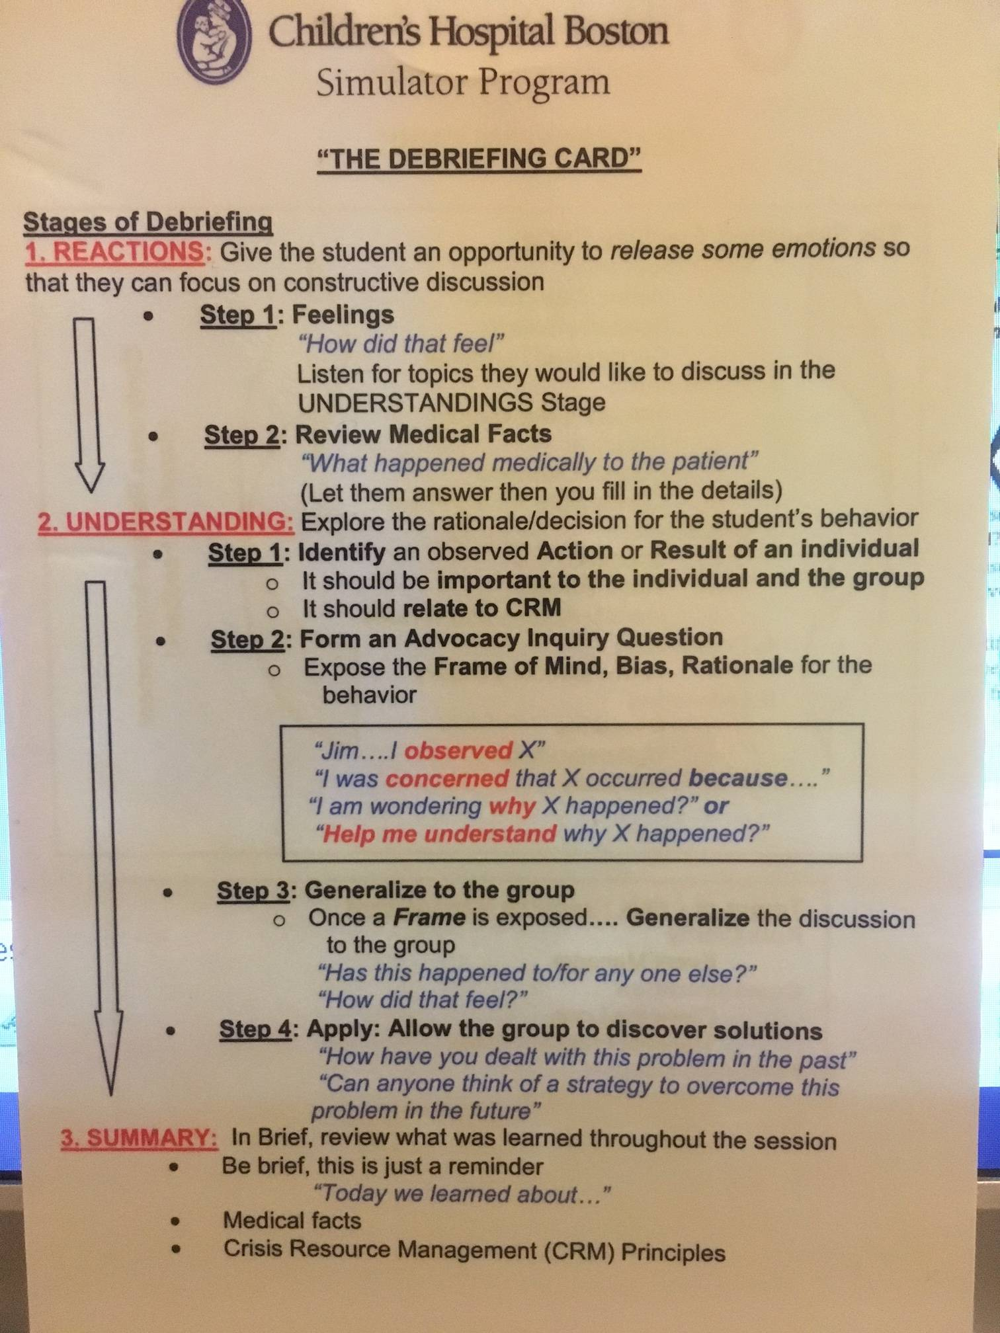
Always Facilitate
Advocacy Inquiry

Slide 10
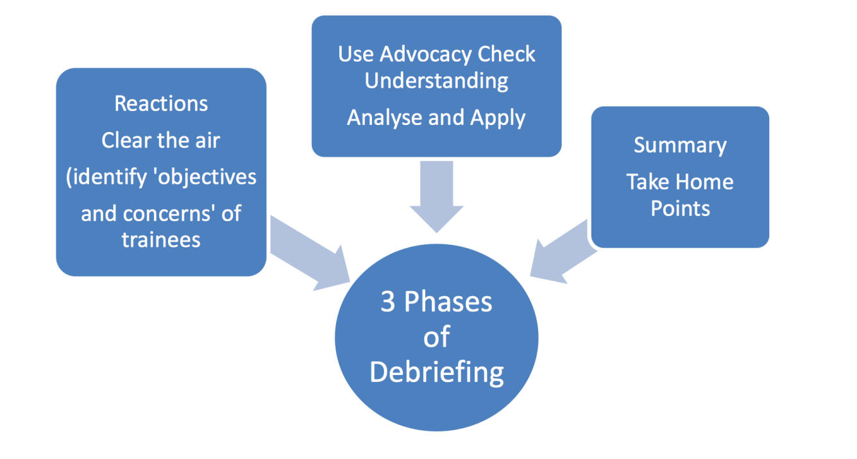


Slide 11


‘to teach or not to teach’
Teaching kills self analysis
  I’m the expert
  When it comes to non technical performance however the candidate holds the solutions
But what about if they just don’t know!!!
  Don’t spend too long
  ?refer to resources

Slide 12
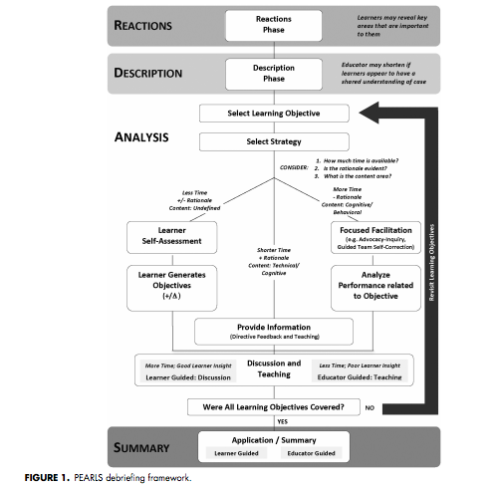

Slide 13


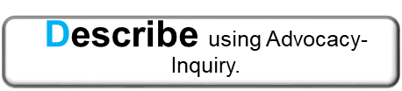
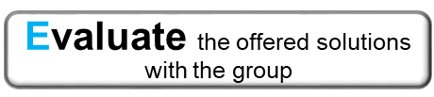


Gosh Unified Debriefing Tool
Prebrief huddle Facilitator/s clarify issues for feedback (Good and bad)
I
“How did that feel?”
Diffuse feelings that may
prevent learning
GU
Gather Up issues from
Participants
Add to your Facilitator list
Use Timeline or +/Δ if not
forthcoming
Select an Issue and apply an appropriate strategy
I D
or
E
Next Issue
Out of Time?
S
Summarise the learning points

Slide 14
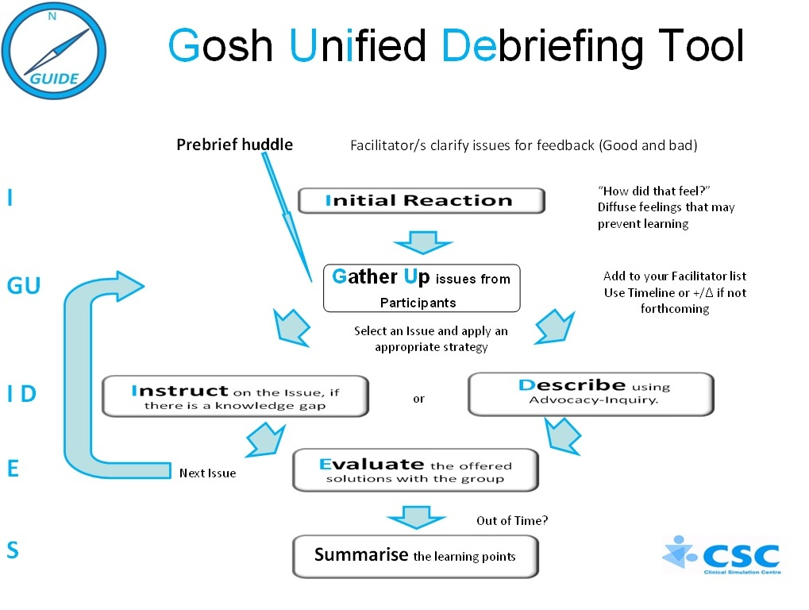

Slide 15
Pre-brief Huddle
Debriefer meet to define the top 5 performance gap issues. The education objectives of the debrief.
  Late O2.
  No role allocation
  No fluid despite hypotension
Ideally do before the scenario end
The participants may start the reactions phase and description immediately the get together

Slide 17

Reactions Phase
Vital to build the facilitator-participant relationship
Can start at the end of the scenario at the bedside
  Remove the candidates if debrief in the same room to break the visual connection
  Can use a faculty intervention requiring a summary(i.e senior staff member arrival)
Open the Basic Tool box

Slide 18
Reactions Phase
How did that Feel?
  What was that like? How did that go?
Allow participants to save face and release the emotions that will hold back analysis
Reflect. ‘Yes that can be challenging
Look around the room to meet all eyes—use silence

Slide 19
Reactions Phase
Gather Up
  Add to or match to your learning objectives/performance issues
Describe the way forward from here
  ‘shall we walk through the scenario’
  ‘Some great points I see we should return to X or Y
  ‘I also have some observations we could discuss’

Slide 20
Gather up the Issues they give you and add them to the ones who have chosen

Slide 21

Choice a topic
The one most important to the learner?
The one most important to the Debriefer?
The one already opened and being analysed by the learners?
The elephant in the room that one can’t ignore

Slide 22
Choose one and Description Phase
Now Gathered up—choose a topic
Non Technical---DESCRIBE/ANALYSE IT
Technical/Knowledge—TEACH/INSTRUCT about it

Slide 23
Description Phase
If a Knowledge Issue
  +/_ and open question
  ?Open with A/I starter
Then teach—close the Knowledge Gap

Slide 24
Description Phase
If a Performance (non technical) Issue:
  Use Advocacy Inquiry to raise a difficult topic
  Use Advocacy Inquiry to reveal the mental ‘frame’ that powers behaviour and thinking
  Use Advocacy Inquiry to bring solutions from the participants

Slide 25
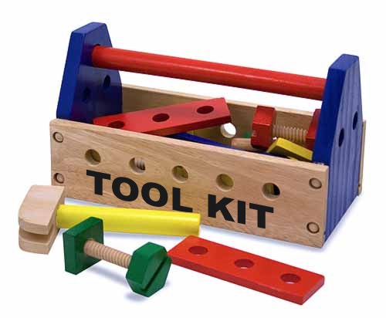
Open the Basic Debriefer’s Toolkit
  1)Use Open Questions to encourage comment
  2)Actively Listen
  3)Use Advocacy Inquiry
  Target a tricky issue quickly and effectively whilst minimising the emotional response
  Tame the rampaging elephant in the room

Slide 26
Open versus closed
Open Q gets an explanation
Closed can be answered with a yes or know

Slide 27
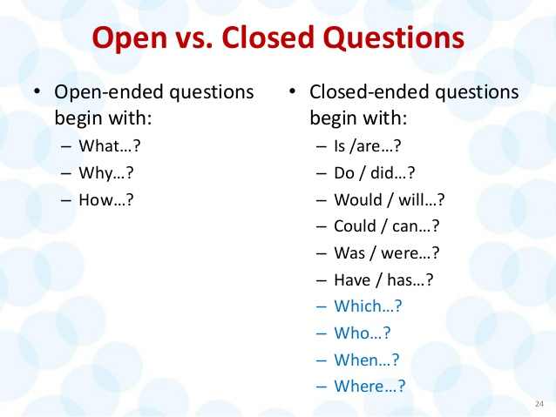

The Basic Toolkit
Open Questions

Slide 28
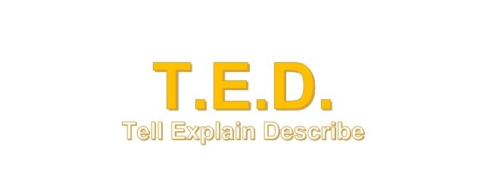
Tell me about that
Explain your thinking to me
Describe how you felt/what you did/your thinking

Slide 29


Slide 30
Spot Open and Closed Q’s
Post it notes
https://www.youtube.com/watch?v=DyO2kS7ajqY
Post it notes
https://www.youtube.com/watch?v=DyO2kS7ajqY

Slide 31
Is there anything you can do to help that? Y/N
Would that have helped?—Y/N
What can someone do to help with that?
Did you give adrenaline?--Y/N
Was not giving adrenaline the correct thing to do?—Y/N
I noticed that by 10mins you didn’t give Adrenaline….What was on you mind at that time?
How did that feel?
That is interesting how does that work?
What was on you mind then?
Why would someone miss that?
What is the consequence of that?
What
Why
How

Slide 32
The Basic Toolkit
Active Listening
https://www.youtube.com/watch?v=oWe_ogA5YCU

Slide 33
Active Listening
Non Verbal (Active Listening)
  Body Language: Turn with Open positioning
  Eye Contact (time referencing notes)
  Eye Contact (eye contact to encourage input)
  Look for preverbal cues
  Use Silence
Verbal
  Open Succinct Questions
  Avoid Multistem Questions
  Try not to interrupt
  Speak Last—when comments are done
  Summarise what you heard
  Reflect back a key word

Slide 34
Advocacy Inquiry
A tongue twister
A method that deals with a difficult issue but:
  Attempts to avoid accusation by using facts
  Attempt to avoid judgement that causes defensiveness by using ‘good judgement’
  Avoid emotional statements or bias and advocate an issue is universal in terms of safety

Slide 35
Advocacy Inquiry
Can help participants to open up to the inquiry (question) and seek an answer as they accept your good judgement as it’s in the interests of the patient
Can help when debriefing very senior staff
Very useful In the emotional state of
  a very bad scenario
  ‘hot’ clinical debrief

Slide 36
Advocacy Inquiry
Advocacy means a statement by someone who has an interest (who cares)
Inquiry is a question

Slide 37

Advocacy
(harder bit)
Advocacy has 2 parts
  1) A factual observation devoid of all adjectives or judgement
    “Richard I observed you placed an O2 mask after the sats had been low for about 5 min”
    “I saw the that a leadership roles were not allocated until the 2nd round of adrenaline”

Slide 38
Advocacy
(harder bit)
Advocacy has 2 parts
  2) A concern or judgement that states why you think this issue was important and worth bringing up. Why you advocating your observation
    I am concerned/understand that supplying O2 early can help with pt outcome

Slide 39

Inquiry (the easier bit)
Inquiry is a open question (What,Why,How)
  What was on you mind?
  How were you thinking at that point?
  Why was that your focus at that time?

Slide 40
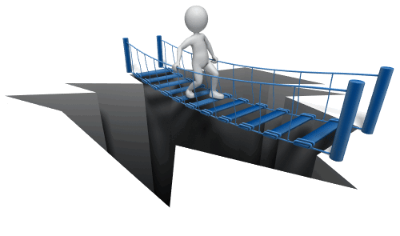
Advocacy Inquiry
Pitfalls
  A tongue twister (takes practice)
  May not be natural
  The purists approach
    Only a few/several topics
    To launch an issue
    Can use again or explore with open Q’s
    Offer(teach) solutions

Slide 41
Advocacy Inquiry
1) Advocacy Observation | 2) Advocacy factual concern | 3) Inquiry (Open Q)
I observed that x happened….. | I am concerned because x can cause effect Y /worried/ (no emotion or bias) Based on a best practice need. | What was on you mind? How were you thinking at that point? Help me understand? explore/discover a ‘frame’

Slide 42
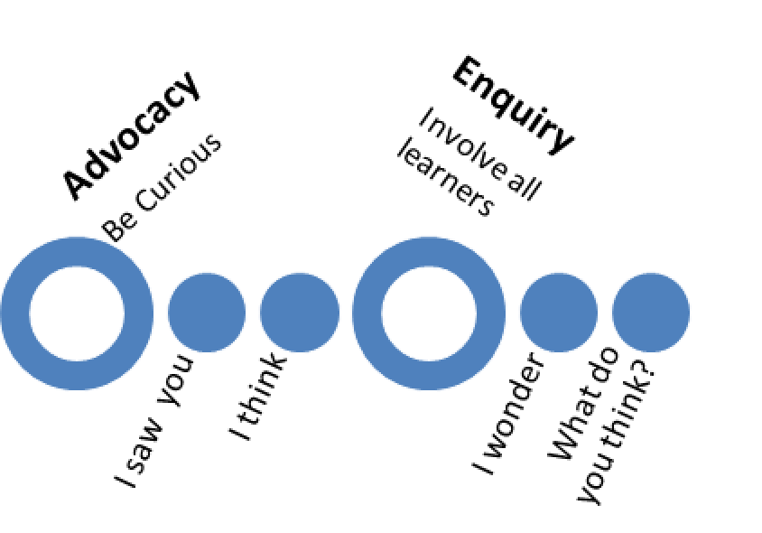
Form AI:
  You are debriefing a theatre team who are responding to a with a clot in the artery to a kidney graft
  https://www.youtube.com/watch?v=dSKgtaWuV4w
Please gather issues that you would like to
Raise and then analyse.

Slide 43
  A few examples:
    A) Lead Surgeon (Dr Gerard) wished to forego the checklist to avoid delay
    B) Observing Surgeon (Dr Benton) may have delayed the process to finish his point
    C) Theatre Nurse Lynn raised issue around reperfusion fluid
    D) How do you approach the use of checklists?
  Any others?

Slide 44
Quick Fire AI
  You are debriefing a team who started the stabilisation of a hypotensive 4yr with Sepsis
  Gathered Issues:
    A) 20mls/kg given but then no more despite no improvement (reg Stephen)
    B) Sarah (reg) tried for 10mins for IV access and then setup a CVL
    C) Patient started to become Hypoxic ‘we need intubation drugs not to anyone just ‘into the air’
    D) No inotropes though about before anaesthesia
      In debrief Jane (sister) had said she had thought about them

Slide 45
Quick Fire AI
  You are debriefing a team who are the first responders to a new onset seizure on the ward
  Gathered Issues:
    A) Jacob (Student Nurse) left the room to get help
    B) Sarah (sister) started to bag the patient without airway positioning and scrunched up under the monitor
    C) Syed (reg) was unsure of the SE protocol or the dose of Lorazepam required
    D) CSP (Tim) and Anaesthetic Reg (Juan) seemed to disagree about whether the bagging was effective and the need to intubate

Slide 46
Quick Fire AI
  You are debriefing a theatre team who responded a major haemorrhage in the operative field
  Gathered Issues:
    A) Samantha (surgeon was aware of the bleeding but apart from swearing did not communicate to all)
    B) Tom (anaesthetist) gave a dose or Metaraminol drawn up by the ODA but didn’t check the dosage/concentration
    C) Ben (ODA) spotted that Tom was picking up a syringe of Fentanyl to give as a flush and stopped him in time
    D) Emily (scrub nurse) had anticipated the surgeons needs in advance and called for extra sutures, packs and Surgicel

Slide 47

Advocacy Inquiry
The Spotlight
  Hot for the recipient
May need to move away (Advanced Toolkit)
  Generalise
    ‘anyone else experienced similar challenges’
  Normalise
    ‘common to have challenges like that’

Slide 48
Summarise the Solutions
‘Close the Gap’
So we have discussed the importance of X,Y,Z
What thing can we take away with us today?

Slide 49
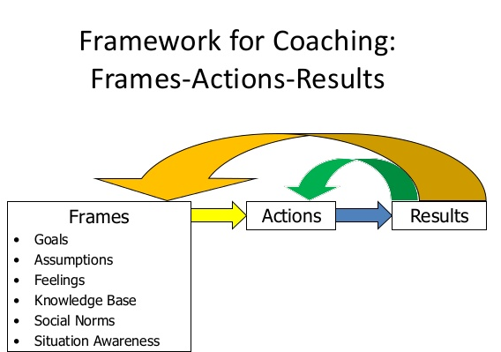

Slide 50
What is a frame?
Spot the Frames
https://www.youtube.com/watch?v=wuzBLu_IZCw
https://www.youtube.com/watch?v=vFHYiOfBRng

Slide 51

A Frame
  I can see that no one can read my mind and therefore I need to share things
  I come up with great ideas but no one responds to them
  I never verbally check doses my ODA gives me
  I had no idea what was going on so I froze
  I knew what the issue was but she’s the consultant and she should know too

Slide 52
Preludes to a frame?
Spot the Frames
  Because
  I believe/don’t believe
  Usually
  I thought
  In my experience
  I usually
  It is always
  The reason was
  That is a waste of time

Slide 53
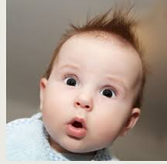
Any Questions?

